Slide 1
QUESTIONS?
Operations
how many?
which ones
Operands
how many?
Location
Types
how to specify?
instruction format
Size
how many formats?
how does the computer know what0001 0100 1101 1111means?
ALL ABOVE SPECIFY DESIGN OF INSTRUCTIONS

Slide 2
INSTRUCTION SET ARCHITECTURE
HOW TO TALK WITH COMPUTER ?
PROVIDES COMMAND TO THE PROCESSOR
WHAT IS CONSISTS OF ?
addressing modes
instructions
native data types
Registers
memory architecture
Interrupt
exception handling
external I/O.

Slide 3
GOAL
EASINESS FOR PROGRAMMER
Designing an ISA is to make a CPU which has enough functionality so that programmers can write programs for it.
we need instructions to do basic maths, data comparisons, deal with data of different sizes, and instructions to branch and jump.
There are an infinite number of ways we can build instruction sets to achieve the above.

Slide 4
WHAT ISSUES ISA IS GOING TO HANDLE?
Registers
Bus Sizes
Operations
How Many Operands?
Instruction Format

Slide 5
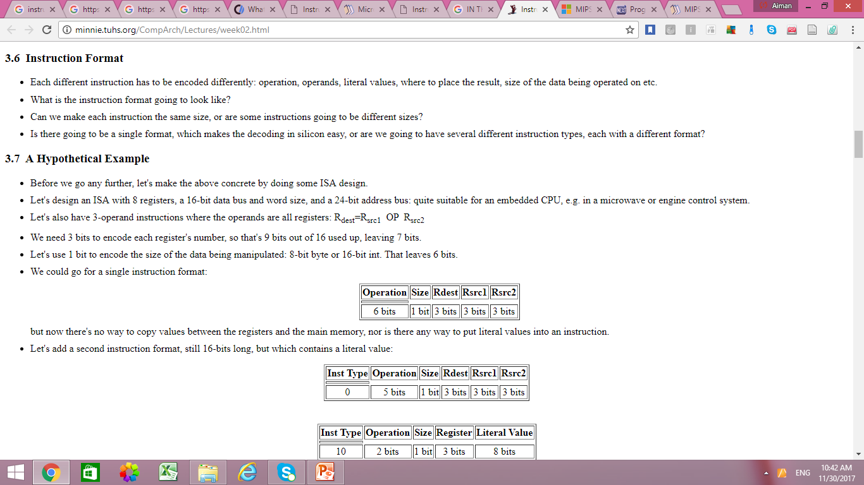
EXAMPLE
Let's design an ISA with 8 registers, a 16-bit data bus and word size, and a 24-bit address bus: quite suitable for an embedded CPU, e.g. in a microwave or engine control system.

Slide 6
TYPES OF ISA
CISC
RISC

Slide 7
TYPES OF ISA
CISC
RISC

Slide 8
CISC
WHAT MEANS TO COMPLEX? → EASINESS FOR PROGRAMMER
ISA designers created instruction sets with instructions to do everything, and the instructions themselves performed complex operations. Instruction sets of this type are now known as CISC architectures.
CISC ISAs made writing programs in assembly much easier for the programmers.
NUMBER OF MEMORY ACCESS
number of memory accesses to perform a CISC instruction can vary from 1 (instruction fetch) to several.
EXECUTION TIME
This implies that CISC instructions take variable amounts of time to execute, depending on their complexity and the number of memory accesses required

Slide 9
RISC
WHAT MEANS TO REDUCE?
It does not mean that the number of operations was reduced (although this did happen), but that the instructions available performed simpler tasks
instructions were simpler, there were more registers, the number of addressing modes was reduced
FOR PROGRAMMER?
EXECUTION TIME ?

Slide 10
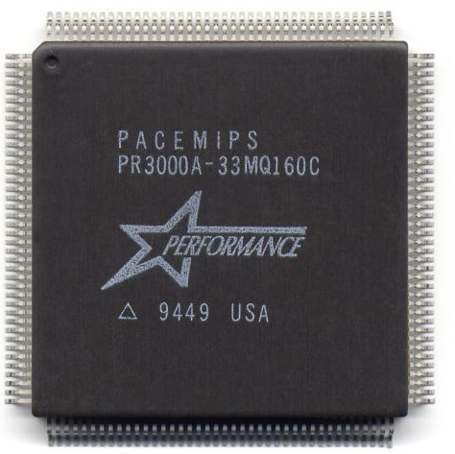
MIPS ISA
RISC OR CISC?

Slide 11
MIPS ISA
DATA BUS AND ADDRESS BUS
The data bus size (and the word size) is 32 bits, and the address bus is 32 bits too.
DATA TYPES
MIPS supports 4 integer data types: 8-bit bytes, 16-bit halfwords, 32-bit words and 64-bit doublewords.
FLOATING POINT
Floating point types are also supported: 32-bit single-precision and 64-bit double-precision values.
REGISTERS
MIPS provides 32 general-purpose 32-bit registers, although the operating system, assembler and libraries reserve some of these for special use.

Slide 12
INSTRUCTIONS IN MIPS
load registers with values, either from RAM or with literal values.
store register values (i.e. copy them) out to RAM locations.
basic integer arithmetic: add, subtract, multiply, divide with remainder.
basic floating-point arithmetic: add, subtract, multiply, divide.
logical operations: AND, OR, NOR, exclusive OR (XOR).
shift operations: shift left, shift right.
comparison operations: ==, !=, <, >, <=, >=
instructions to change the flow of control: relative branches and jumps.

Slide 13
INSTRUCTION FORMAT
R-type instructions, which perform arithmetic and logical operations on registers.
I-type instructions, which deal with load/stores and immediate literal values, as well as branches.
J-type instructions, which are used for jumps and function calls.

Slide 14
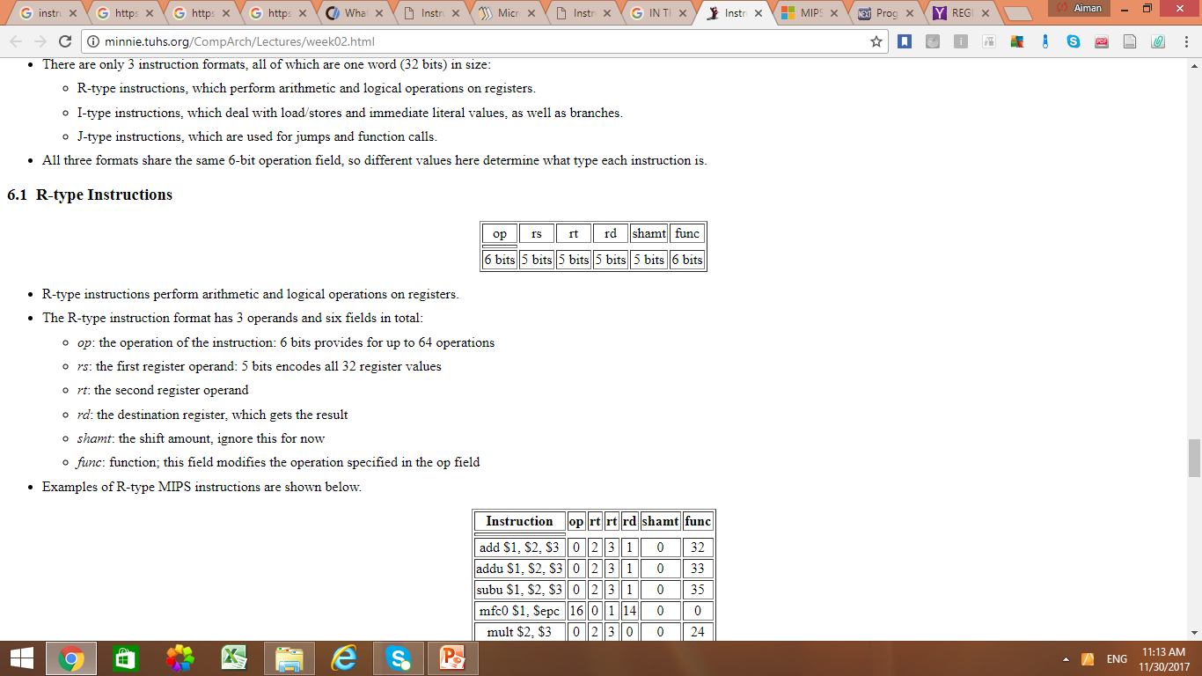
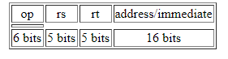
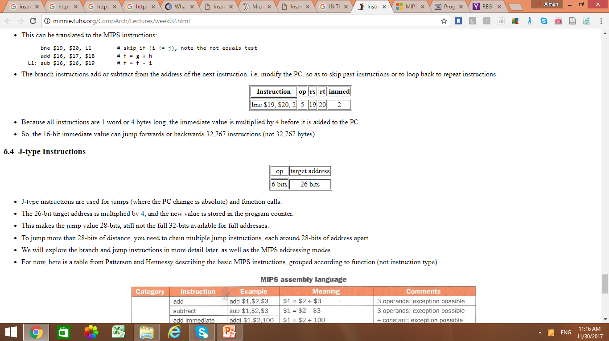
R-TYPE VS I-TYPE VS J-TYPE

Slide 15
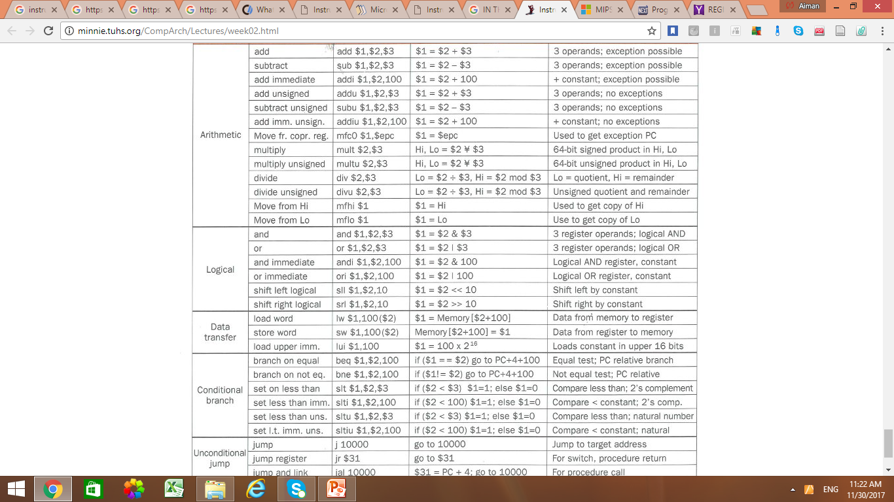
MIPS ASSEMBLY INSTRUCTIONS

Slide 16
FIRST PROGRAM IN MIPS ASSEMBLY

Slide 17
.DATA, .TEXT, & .GLOBL Directives
.DATA directive
Defines the data segment of a program containing data
The program's variables should be defined under this directive
Assembler will allocate and initialize the storage of variables
.TEXT directive
Defines the code segment of a program containing instructions
.GLOBL directive
Declares a symbol as global
Global symbols can be referenced from other files
We use this directive to declare main procedure of a program

Slide 18
System Calls
Programs do input/output through system calls
MIPS provides a special syscall instruction
To obtain services from the operating system
Using the syscall system services
Load the service number in register $v0
Load argument values, if any, in registers $a0, $a1, etc.
Issue the syscall instruction
Retrieve return values, if any, from result registers

Slide 19
Syscall Services
Service | $v0 | Arguments / Result
Print Integer | 1 | $a0 = integer value to print
Print Float | 2 | $f12 = float value to print
Print Double | 3 | $f12 = double value to print
Print String | 4 | $a0 = address of null-terminated string
Read Integer | 5 | Return integer value in $v0
Read Float | 6 | Return float value in $f0
Read Double | 7 | Return double value in $f0
Read String | 8 | $a0 = address of input buffer $a1 = maximum number of characters to read
Allocate Heap memory | 9 | $a0 = number of bytes to allocate Return address of allocated memory in $v0
Exit Program | 10

Slide 20
Syscall Services – Cont’d
Print Char | 11 | $a0 = character to print
Read Char | 12 | Return character read in $v0
Open File | 13 | $a0 = address of null-terminated filename string $a1 = flags (0=read, 1=write, 9=append) $a2 = mode (ignored) Return file descriptor in $v0 (negative if error)
Read from File | 14 | $a0 = File descriptor $a1 = address of input buffer $a2 = maximum number of characters to read Return number of characters read in $v0
Write to File | 15 | $a0 = File descriptor $a1 = address of buffer $a2 = number of characters to write Return number of characters written in $v0
Close File | 16 | $a0 = File descriptor

Slide 21
Reading and Printing an Integer
################# Code segment #####################
.text
.globl main
main: # main program entry
li $v0, 5 # Read integer
syscall # $v0 = value read
move $a0, $v0 # $a0 = value to print
li $v0, 1 # Print integer
syscall
li $v0, 10 # Exit program
syscall

Slide 22
Reading and Printing a String
################# Data segment #####################
.data
str: .space 10 # array of 10 bytes
################# Code segment #####################
.text
.globl main
main: # main program entry
la $a0, str # $a0 = address of str
# (note: la is a pseudo instruction)
li $a1, 10 # $a1 = max string length
li $v0, 8 # read string
syscall
li $v0, 4 # Print string str
syscall
li $v0, 10 # Exit program
syscall

Slide 23
YOUR TASK
WRITE A PROGRAM IN MIPS ASSEMBLY TO TAKE THREE INTEGERS FROM USER AND STORE THEIR SUM ON SCREEN.

